Slide 1
Automated Redaction
MACHINE LEARNING TOOL FOR MASKING PERSONAL INFORMATION
BY G291
Meghana Jakku
Bandaru Somi
B. Ruchira Reddy
B. Mounika
Chinmayi Thumma
Manaswini .K
MENTOR
DR SHILPA CHOUDHARY

Slide 2
INTRODUCTION
Automated redaction is a crucial technology for protecting sensitive information in various industries, particularly in healthcare, legal, media and publishing sectors. By leveraging advanced techniques like natural language processing (NLP) and machine learning, automated redaction enables the efficient identification and removal of confidential data from documents.

Slide 3
PROBLEM STATEMENT
"RE-DACT" is a sophisticated machine learning-based redaction tool that ensures the secure handling of sensitive information across various formats, including text files, PDFs, CSVs, and Word documents. Utilizing advanced natural language processing (NLP), deep learning models, and the Pategan model for generating synthetic text, it efficiently identifies and redacts sensitive data, such as personal identifiers, while preserving the structure and coherence of the original content. This enables enhanced privacy protection while maintaining the usability of the data.

Slide 4
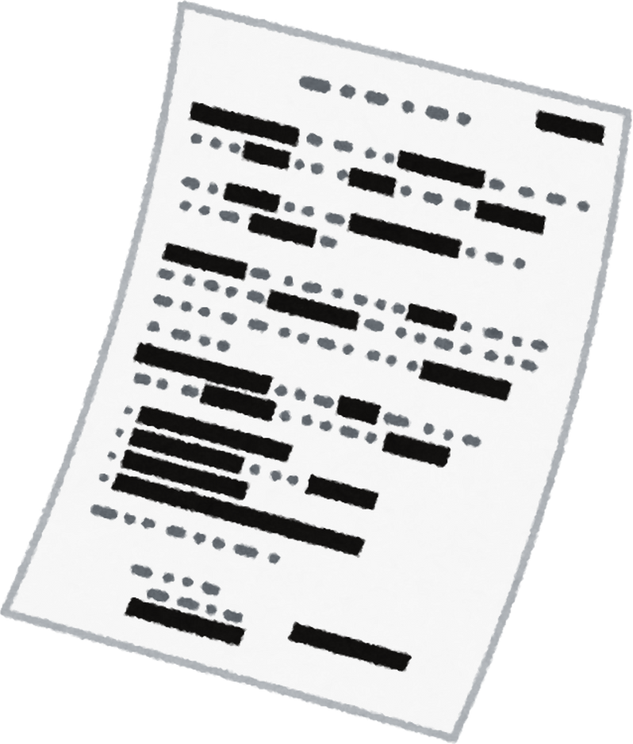
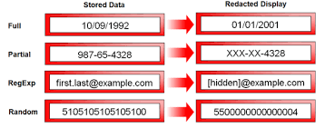

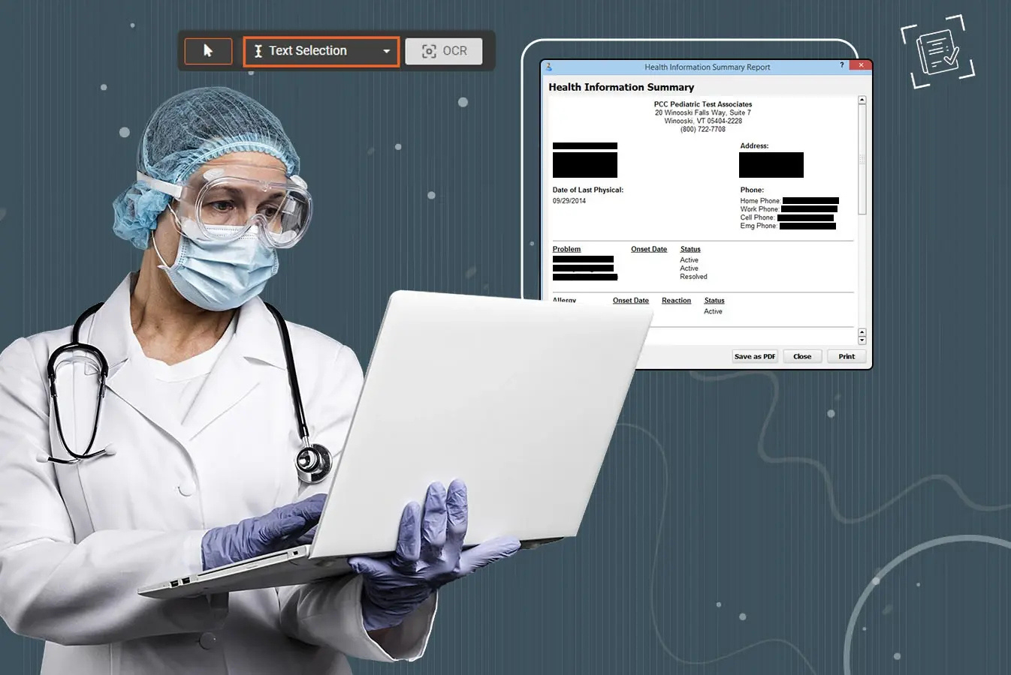
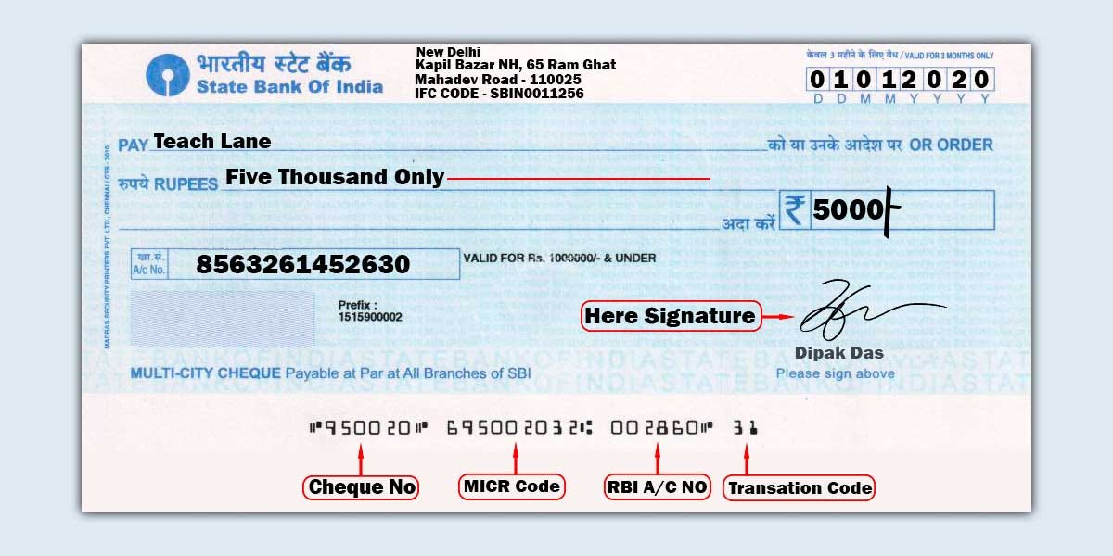
BUSINESS CASES
Healthcare
Legal Sector
Financial Services
Government
Education
Media & Publishing

Slide 5





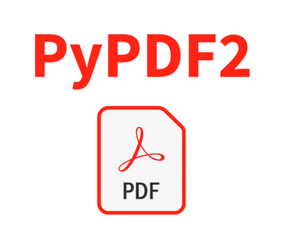

TECHNOLOGY STACK
Python
DeBERTa model
PATE-GAN
TensorFlow
PyPDF2
Streamlit(UI)
NumPy and Pandas
Scikit-learn
XGBoost

Slide 6
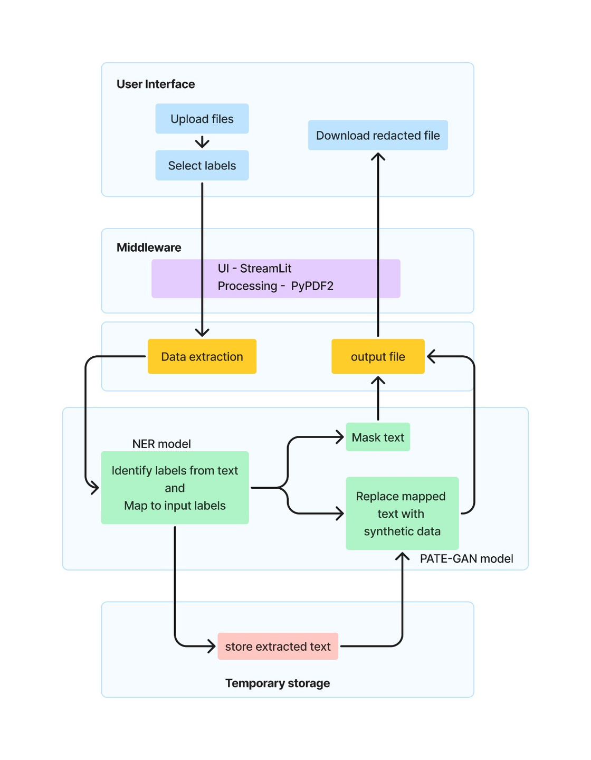
ARCHITECTURE DIAGRAM
User Interface : end user interaction
Middleware : to process .txt, .docx,.pdf .csv files
Backend : NER model for identifying and masking data and PATE GAN model for generating synthetic data.
Temporary Storage :store details, uploaded and redacted files.

Slide 7
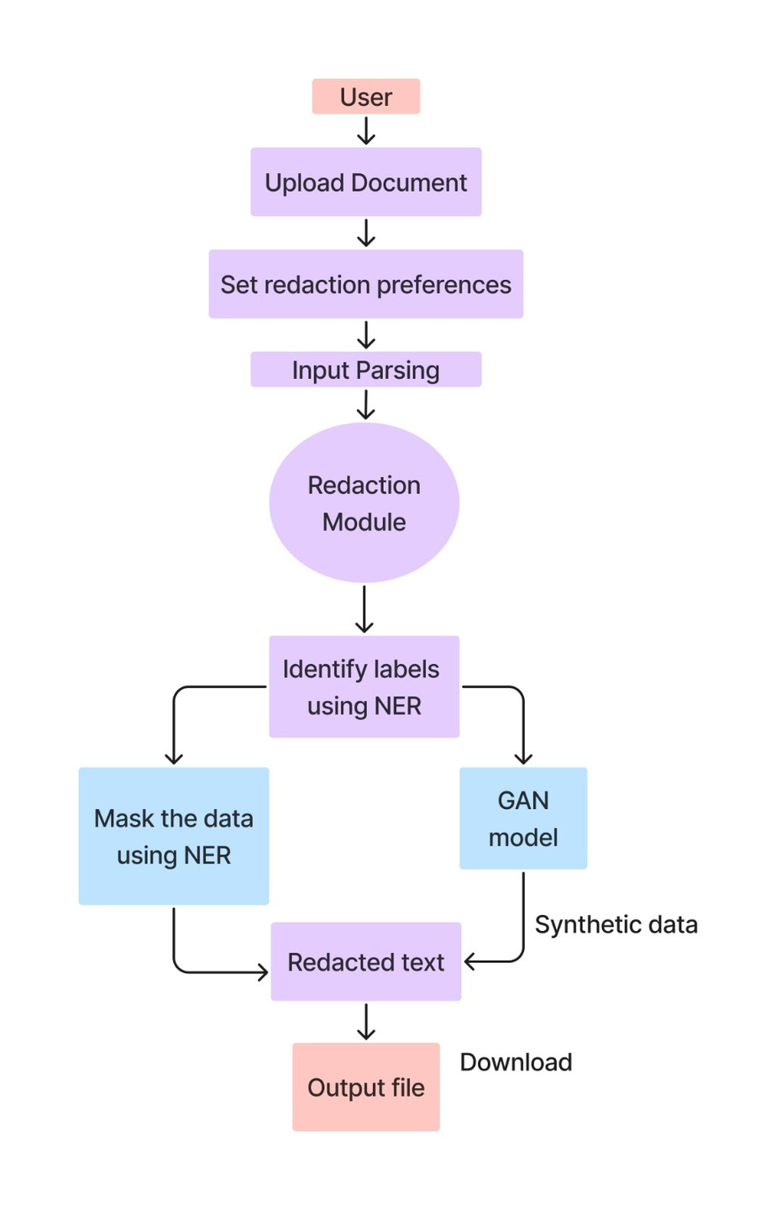
DATA FLOW DIAGRAM
Redaction process:
users upload a document, set redaction preferences, and parse input. The redaction module identifies sensitive data using NER, either masking it or generating synthetic data via a GAN model. The processed text is exported as an output file.

Slide 8
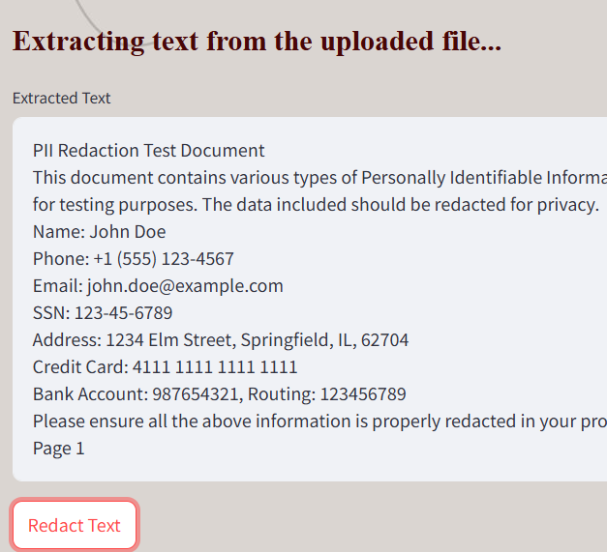
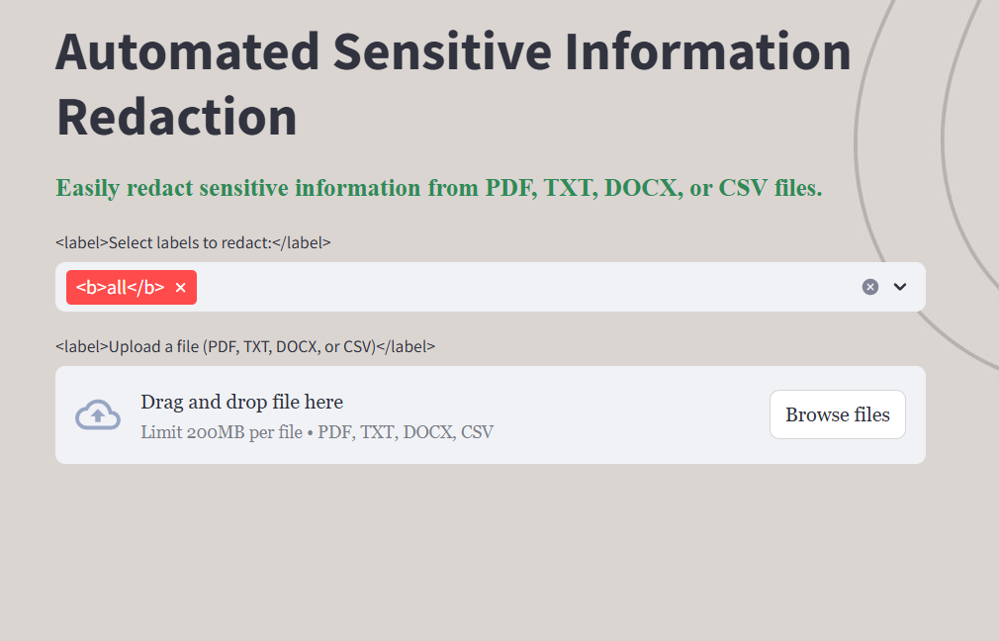
USER INTERFACE

Slide 9
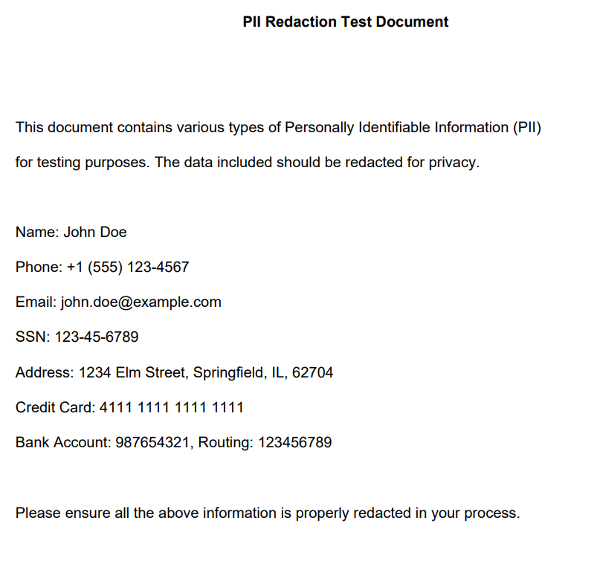

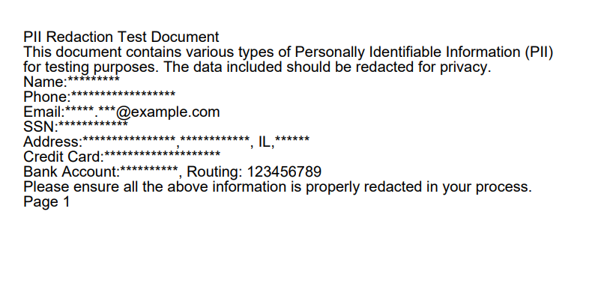
REDACTION RESULTS
Original PDF
Masked output

Slide 10
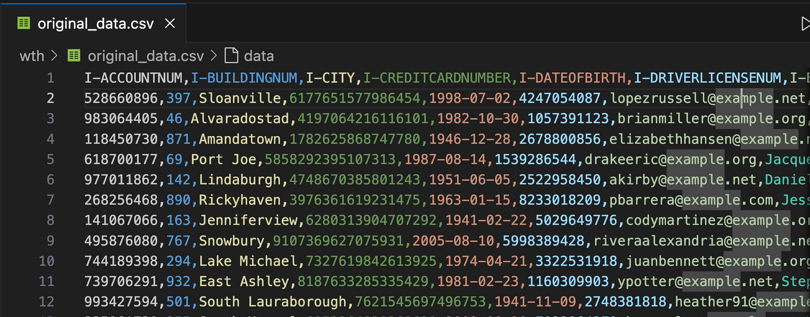
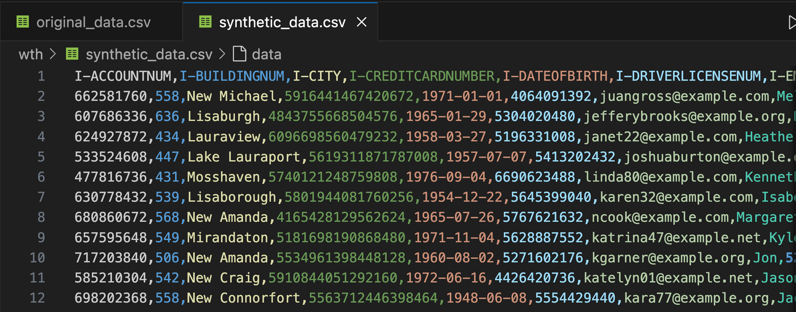
original csv
generated fake csv

Slide 11
CONCLUSION
To conclude, this project developed an automated redaction framework using NER models to identify and mask sensitive labels and PATE-GAN to generate synthetic data, ensuring data privacy. This approach enhances data security while maintaining usability. In the future, we aim to integrate PATE-GAN directly into the redaction process to replace sensitive text with synthetic data, preserving relationships and context within the text for enhanced usability.

Slide 12
THANK YOU

